Slide 2
FINAL PROJECT OF PROGRAMMING FUNDAMENTALS

Slide 3
GROUP MEMBERS:
SHAHZEB ABRO (CT-034)
SYED SUMAM ZAIDI (CT-038)
MUHAMMAD UMAIR SHAIKH (CT-048)
MUHAMMAD ABDUL RAFAY SHAIKH (CT-035)
ROHAN AHMED SIDDIQUI (CT-050)
MUHAMMAD MUSTAFA SHEIKH (CT-049)

Slide 4
GRAPH PLOTTING CLI APPLICATION

Slide 5


Slide 6
INTRODUCTION:
Visualizing data is a tedious task in number form.
But in pictorial (graphical) form things get easy to view and manage.
We present our Project which does the same.
Changes raw data into graphical form.
We achieved this by using a very popular library ‘matplotlib’.
Supported some basic graphs like polynomial, sine, cosine, exponential, straight line and quadratic.
Easy to use and user friendly.

Slide 7
STRAIGHT LINE GRAPH

Slide 8
plt.plot(x, y, marker='o
Start straight line graph
for i in range(0, occurs)
no
input
yes
plt.xlabel('x - axis')
x.insert(i, input('Enter the x coordinate:’))
plt.ylabel('y - axis')
X=0
y.insert(i, input('Enter the y coordinate:'))
plt.title ('Straight Line Graph')
y=0
plt. show()
occurs = int(input('Enter how many coordinates you want to add:'))
continue
end Straight line Graph

Slide 9
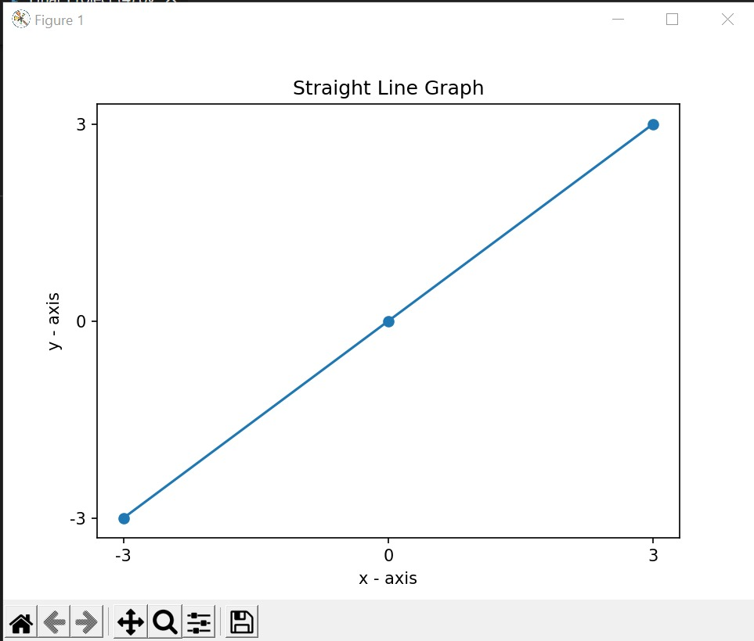
OUTPUT

Slide 10
SINE FUNCTION GRAPH

Slide 11
Start SineFunctionGraph
v = np.sin(u)
Input
plt.show
u = np.arange(0, (2 * np.pi), 0.1)
End Sine Function Graph
plt.title('Sine Function Graph')
plt.plot(u, v)

Slide 12
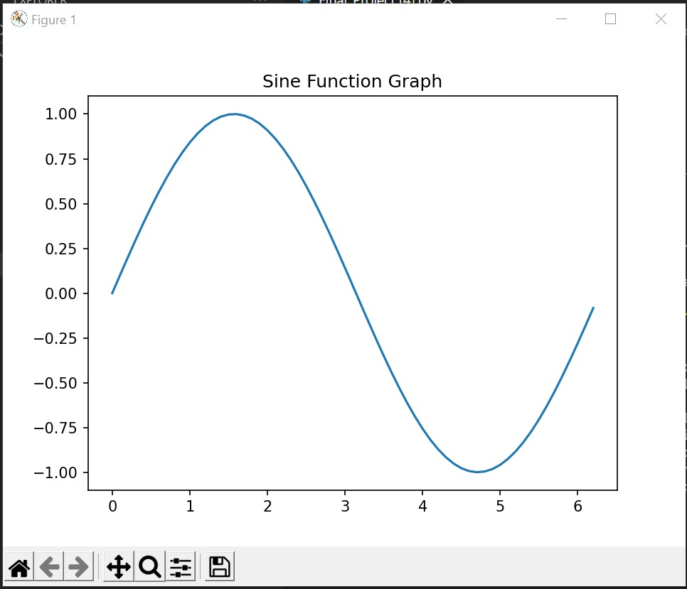
OUTPUT

Slide 13
COSINE FUNCTION GRAPH

Slide 14
start Cosine Function Graph
v = np.cos(z)
Input
plt.show()
z = np.arange(0, (2 * np.pi), 0.1)
end Cosine Function Graph
plt.title('Cosine Function Graph')
plt.plot(z, v)

Slide 15
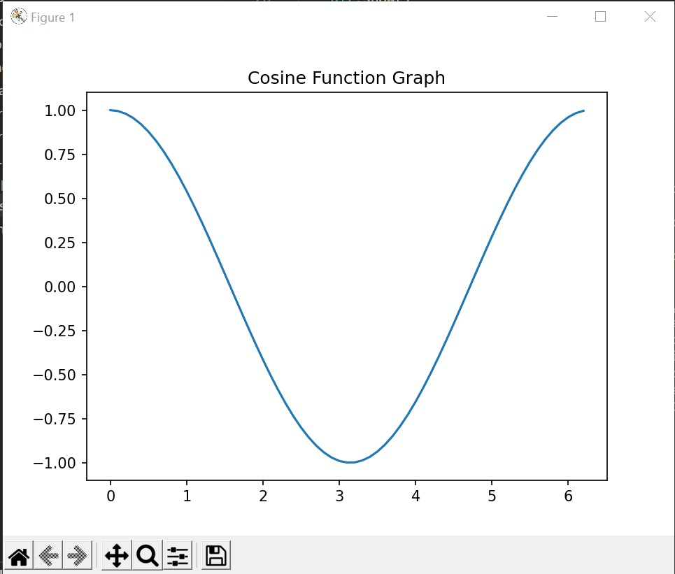
OUTPUT

Slide 16
QUDRATIC EQUATION GRAPH

Slide 17
start quadratic equation graph
plt.title(Quadric Equation Graph')
input: a, b, c :
a = int(input('Enter the coefficient of x^2:'))
x = list(range((- 5), 5))
plt.ylabel('y-axis')
plt.xlabel('x-axis')
plt.plot(x, y, marker='o')
c = int(input('Enter the constant:'))
y = [(((a * (i ** 2)) + (b * i)) + c) for i in x]
b = int(input('Enter the coefficient of x:'))
plt.ylabel('y-axis')
end quadratic equation graph

Slide 18
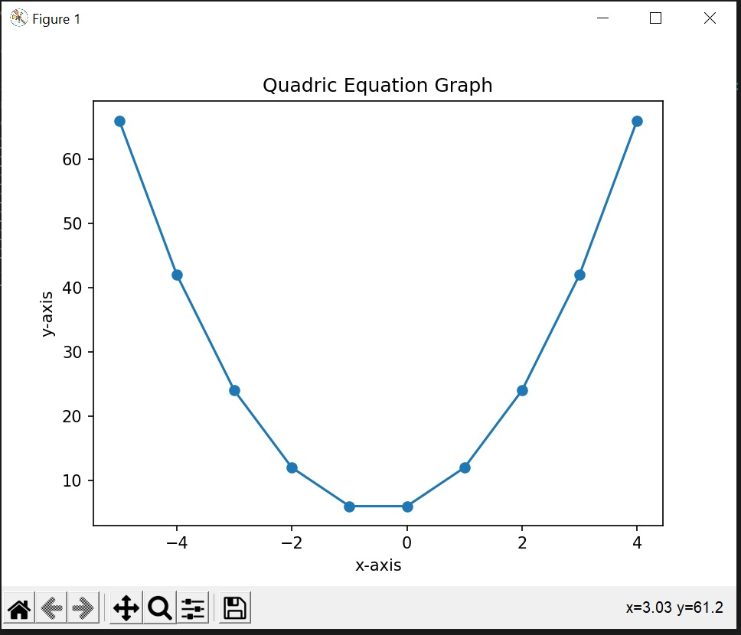
OUTPUT:

Slide 19
EXPONENTIAL CURVE GRAPH

Slide 20
start Exponential Curve graph
plt.ylabel('y-axis')
input: value
plt.title('Exponential Graph')
value = np.arrange ((- 2), 4, 0.001)
plt.grid()
amplitude = np.exp(value)
plt.show()
plt.plot(value, amplitude)
end Exponential Curve Graph
plt.xlabel('x-axis')

Slide 21
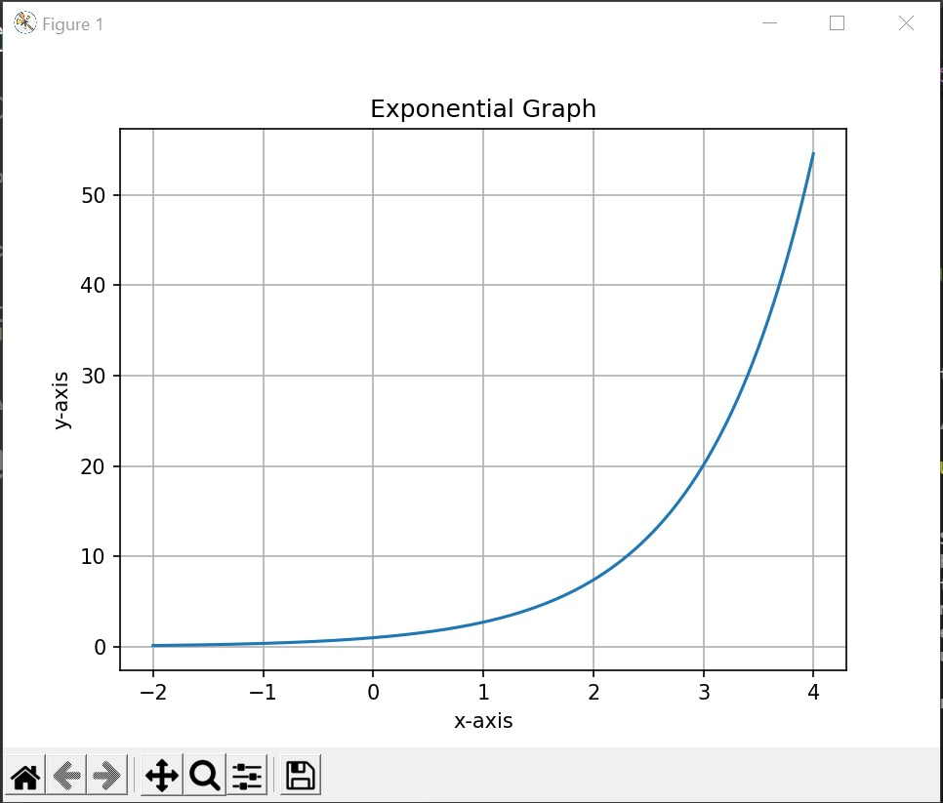
OUTPUT:

Slide 22
POLYNOMIAL CURVE GRAPH

Slide 23
start polynomial Equation Generator
coefficients = []
for i in range(( order + 1)
input:
Start f
input: x
x = np.linspace((- 100), 100, 10000)
coefficient = int(input('Enter coefficient of x^{}: '.format((order - i))))
y = 0
order = int(input('Enter the order of polynomial: '))
y += (coefficients[i] * (x ** (order - i))) while i in range((order + 1))
Coefficients. append(coefficient)
end function return

Slide 24
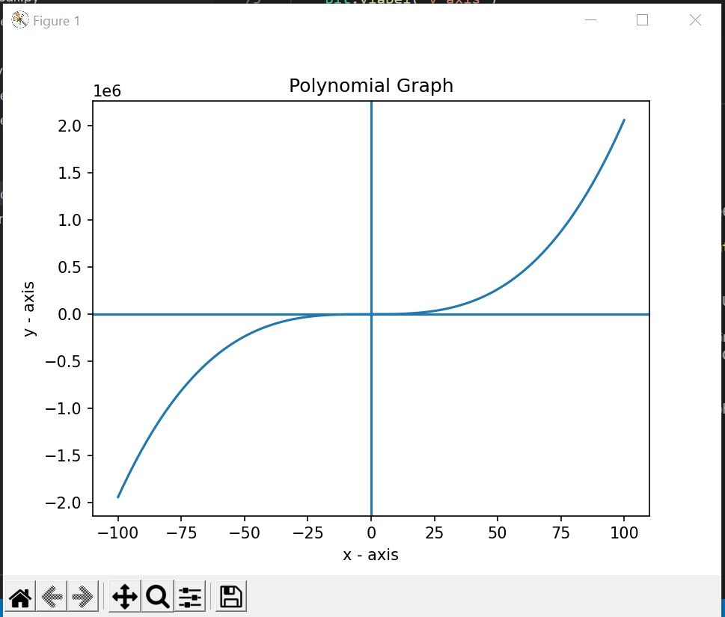
OUTPUT:

Slide 25
MENU

Slide 26
start menu
input:
Exponential Curve(1) if (choice = = 4)
choice = int(input('Please enter your desired key:'))
Sine Function Graph() if (choice = = 5)
Straight line Graph() if (choice == 1)
Cosine Function Graph() if (choice == 6)
Quadric eq(1, 1, 1) if (choice == 2)
print('Thank You For Using Our Program!') if (choice == 7)
Polynomial Caller() if (choice = = 3)
end menu

Slide 27
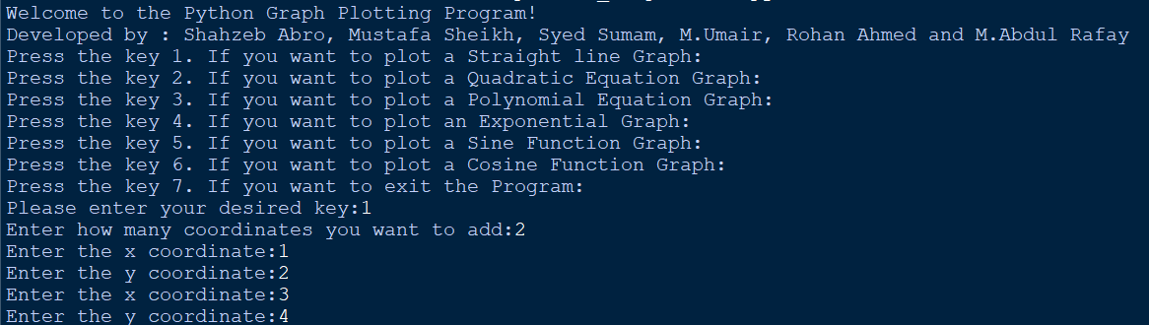
OUTPUT:

Slide 28
ADVANTAGES:
A graph facilitates a user the see the data in pictorial way.
Its advantages is that it displays a lot of information in an understandable way.
By using this project, a user can plot the graph of any equation according to their choice.
This project seems very helpful to those persons whom have to handle large data and sort them and make it effective.
A user can easily equate the graph of equations such as polynomial equation, quadratic equation…. and many more.

Slide 29
DISADVANTAGES:
It is common that disadvantages are linked with advantages in every case, Similarly the disadvantages in this project are mentioned below:
This code is very efficient but not completely optimized, we can add further more advanced level things.
It only provide graphs of generalized equations of some functions as it was to be written in fundamental manner.
Since it is not a robust code it can not provide mean and average of the values as compared to human measurement therefore accurate frequency is not achieved.

Slide 30
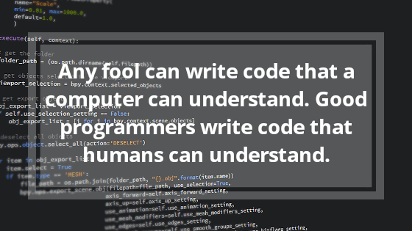

Slide 31
THE END

